Slide 1

FALL 2023
MIS 381N
Information management
Lecture 14
Oct 9th 2023
Prashant D. Joshi
UT McCombs School of Business (MSBA), The University of Texas at Austin

Slide 2

Objectives
Data Governance
Data governance purpose and scope
Selected illustrations
Questions and discussion

Slide 3
What questions may I answer before we begin …
All questions are good questions

Slide 4
Housekeeping
Update on Mid term

Slide 5
Data Governance Purpose and Scope

Slide 6
Recap: Components of Data Management
Business Purpose of Data
Four components of the operating model:
Organization
Governance
Stewardship
Performance management
Centralized or decentralized?
Sponsorship?
Roles and responsibilities?
Funding framework and philosophy?
Characteristics of Data under Management
Data Management Operating Model
Data Management Technology Architecture

Slide 7


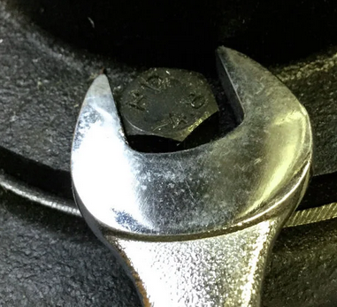

What’s the problem here?
Hey Toolman! This tool is broken; it does not fit the job at hand
Hey! Don’t complain, the tool is perfect… check your work (data!)

Slide 8




On the data front…
Hey IT folks! This tool is broken; it does not work on the data
Hey! Don’t complain, the tool is perfect… check your data!
The Business Side
The Tools Side

Slide 9
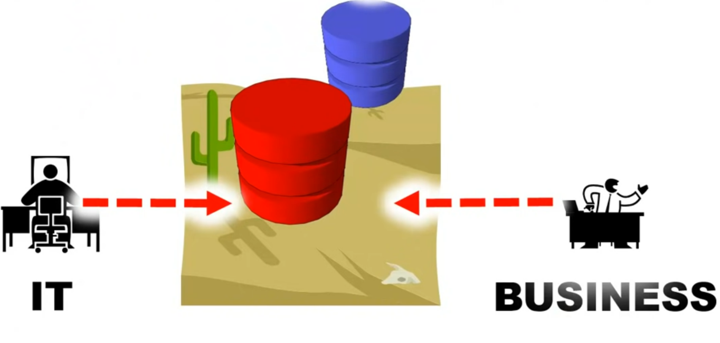
Needs DATA GOVERNANCE
No person’s land!
https://www.youtube.com/watch?v=sHPY8zIhy60

Slide 10
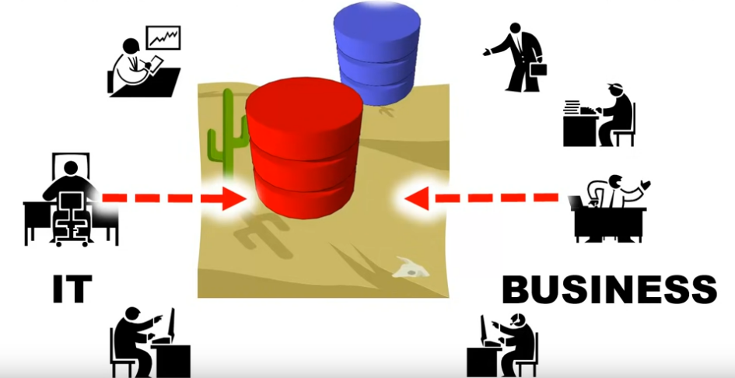

DATA GOVERNANCE required ALL stakeholders
Danger! All talk and no substance!
https://www.youtube.com/watch?v=sHPY8zIhy60

Slide 11
The task of ensuring substance is GOVERNANCE
All Business Units are stake holders as they need to interact using the tools
The IT is a stake holder as they have to support the varied needs of the Bus
IT does not CREATE THE DATA!
IT should create the ‘framework’ for the tools to be uniform across the org
Repeatable, Scalable, Master Data Management, Data Quality, Revision Control, security

Slide 12
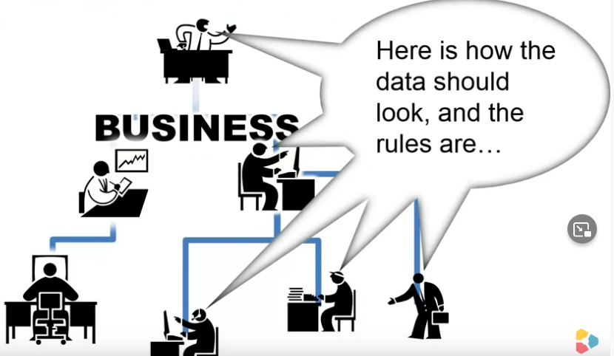
The Business Units should own Governance
BU’s responsibility
Processes
Changes and maintenance to processes
Agreeable terminology
Track progress
So, IT can do their job right
Why? They own the data!
https://www.youtube.com/watch?v=sHPY8zIhy60

Slide 13
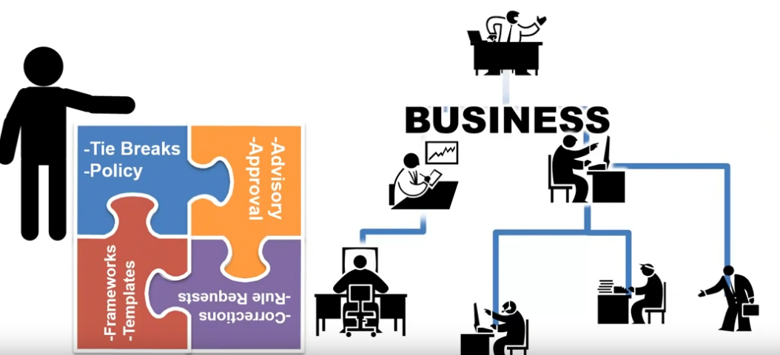
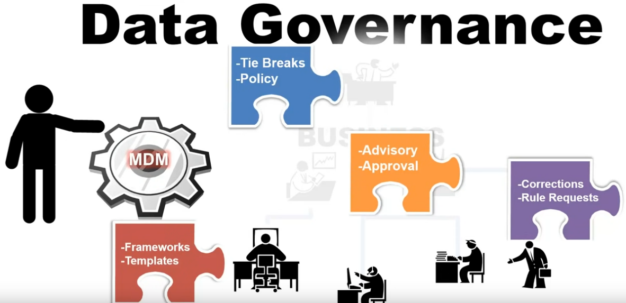
Governance… management!
No one size fits all
But some basic needs to managing… Governance
https://www.youtube.com/watch?v=sHPY8zIhy60

Slide 14
In class example

Slide 15




Example phone call to your bank to get a loan!
Inefficient Data Governance
Application Form folks
May I have your:
Name
SSN
Email
Address
…
…
Reception
May I have your:
Name
SSN
Email
Address
Security Dept
May I have your:
Name
SSN
Strong Password
Address
https://www.youtube.com/watch?v=sHPY8zIhy60

Slide 16
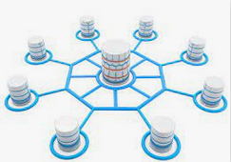
Example phone call to your bank to get a loan!
Reception
May I have your:
Name
SSN
Email
Address
Allow sharing across departments with need-to-know security
https://www.youtube.com/watch?v=sHPY8zIhy60

Slide 17
Example phone call to your bank to get a loan!
FRAMEWORK is needed to enable this!
Policy: Organization policy (governmental, local laws, etc.)
Rules: Data Protection (ex: SSN is protected, Governance is the set of rules)
Classification: Now classify the data coming in correctly (Business terms - language/units standardization, Data Classes - Metadata )
Reception
May I have your:
Name
SSN
Email
Address
https://www.youtube.com/watch?v=sHPY8zIhy60

Slide 18

What’s Needed for Successful Data Governance?
Policies?
Resources?
?
?
?
Issue Tracking?
Procedures?
Metrics?
Connections between
PEOPLE!
Expertise?
Roles defined?
Technology?

Slide 19
What’s really needed?
Fertile Ground – Human Relationships!

Slide 20
Definitions
Data Governance is the practice of organizing and implementing policies, procedures, and standards for the effective use of an organization's … information assets.
- Anne Marie Smith, “Data Governance Maturity - An Overview”
Data Stewardship: The formalization of accountability for the management of data resources -Bob Seiner, “The Data Stewardship Approach to Data Governance”

Slide 21
Value Proposition
Risk reduction
Greater trust in data quality for use in decision making
Cost reduction via improved efficiency
Higher actual return on technology investments
Increased value and utility of data assets

Slide 22
Oversight
Data Access & Use
Data
Governance
Data Standards, Reference Data, Meta Data
Data Quality

Slide 23
Deliverables
Establish a robust Data Stewardship Program to support Data Governance
Develop, publish and manage enterprise-wide data definitions and semantics
Identify, address, resolve and monitor data related issues
Measure, monitor and communicate data quality parameters and issues
Publish and promote policies, procedures and rules, including those related to privacy, regulatory and contractual compliance
Foster a culture and values that promote high quality data related practices and create zero tolerance for errors in mission-critical data
Coordinate and facilitate the integration of data-driven business needs and priorities with IT requirements and constraints
Provide business friendly Data Governance communication

Slide 24
Selected Illustrations

Slide 25
$60B Public Healthcare Services Company

Slide 26
Breadth and Depth of Data
Clinical
Opportunities
Contacts
Payor
Permissions
Clinical
History
Pricing
Group Design
Eligibility
Financial
Preferences
Network
Coverage
Demographic
Administrative
Performance
Provider
Physician
Lab
65+ million lives
3 – 5 years longitudinal history
Near real time availability
PATIENT
Hospital
Pharmacy
Claims
Clinical Reference
Pharmacy
Medical
ICD9
Drug
CPT

Slide 27
Data Quality and Stewardship
Organized by Subject Area
Operational Owner
Subject Matter Expert
Quality Steward
Master Index & Data
Patient
Physician
Resolve data anomalies resulting from payor legacy systems
External Data Integration
Clinical Reference
Address & phone number hygiene
Demographic
Central management

Slide 28
$2B Private Healthcare Services Company
Core Information Technology (CIO)
Business Intelligence Team
Business Groups
Centralized
Transaction systems
Reference data
Master data
Patient, provider index
Centralized
Data warehouse
Standard reporting
Business intelligence tools
Training and education
Distributed
Data Marts
Analytics and interpretation

Slide 29
Carolinas Healthcare System

Slide 30
Healthcare in the US

Slide 31
Background
History and growth of CHC
Changes in market and regulations
Pressure from healthcare ecosystem stakeholders
CHS strategic priorities – patient outcomes and service orientation
Changes in technology

Slide 32
Value from Data
Identify underserved communities
Hospital readmission prediction
Chronic disease management
Consumer segmentation

Slide 33
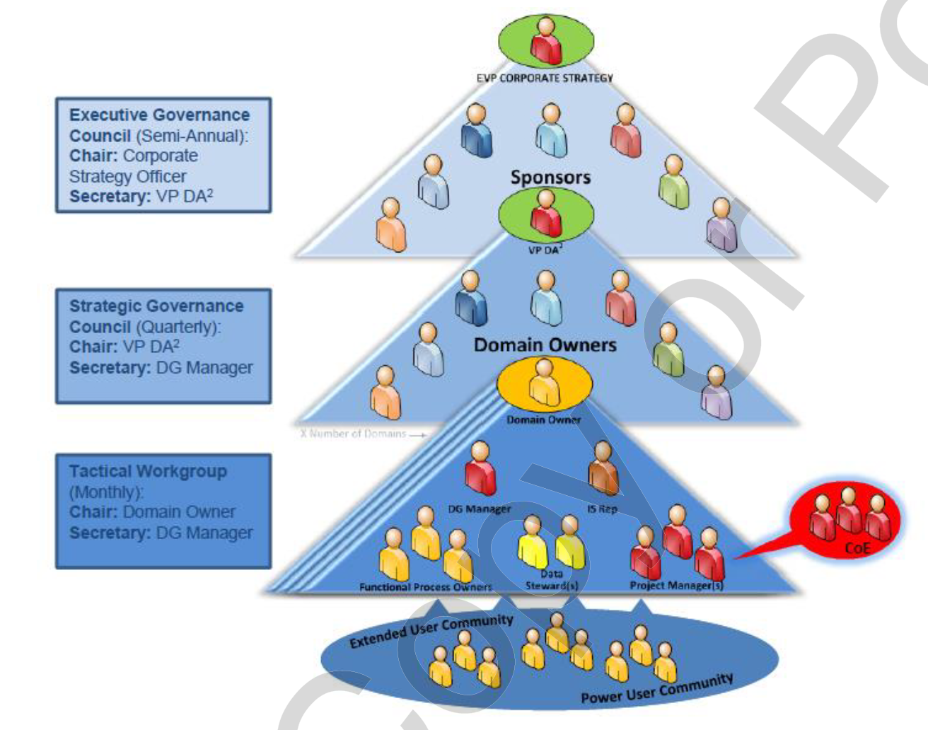
Data Governance

Slide 34
Team Exercise Description
You will be divided into five teams
Spend 20 minutes working as a team
First discuss your answers to all questions
Formulate an in-depth answer to your assigned question
Prepare a 5 minute presentation in PowerPoint
Appoint a spokesman for your team
Present and answer questions

Slide 35

Next class
Topic Focus: Big Data
Read articles and review videos posted on Canvas
Come prepared to discuss and work in teams

Slide 36
What questions may I answer before we conclude …
All questions are good questions

